Slide 1
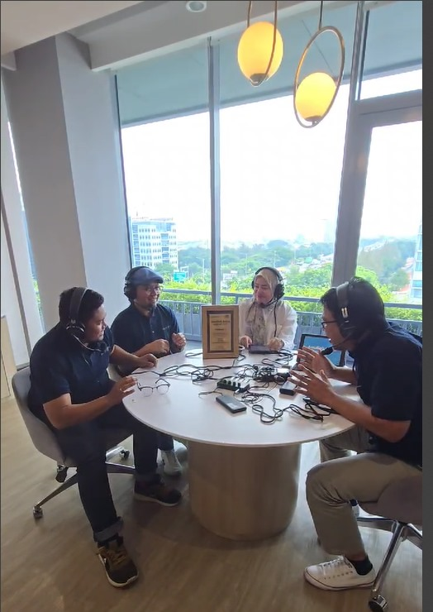

Podcast BKMA ACC
Kunjungi IG : ACCWayschannel

